Slide 1
EX 2 Wiring
Filabot EX2 Filament Extruder
Feb 2023

Slide 2
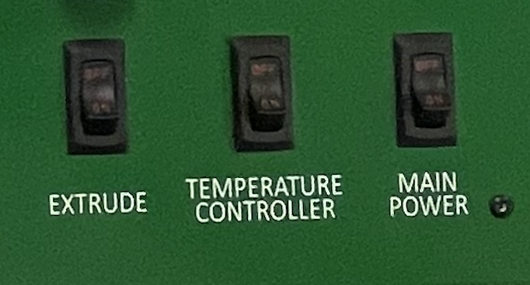
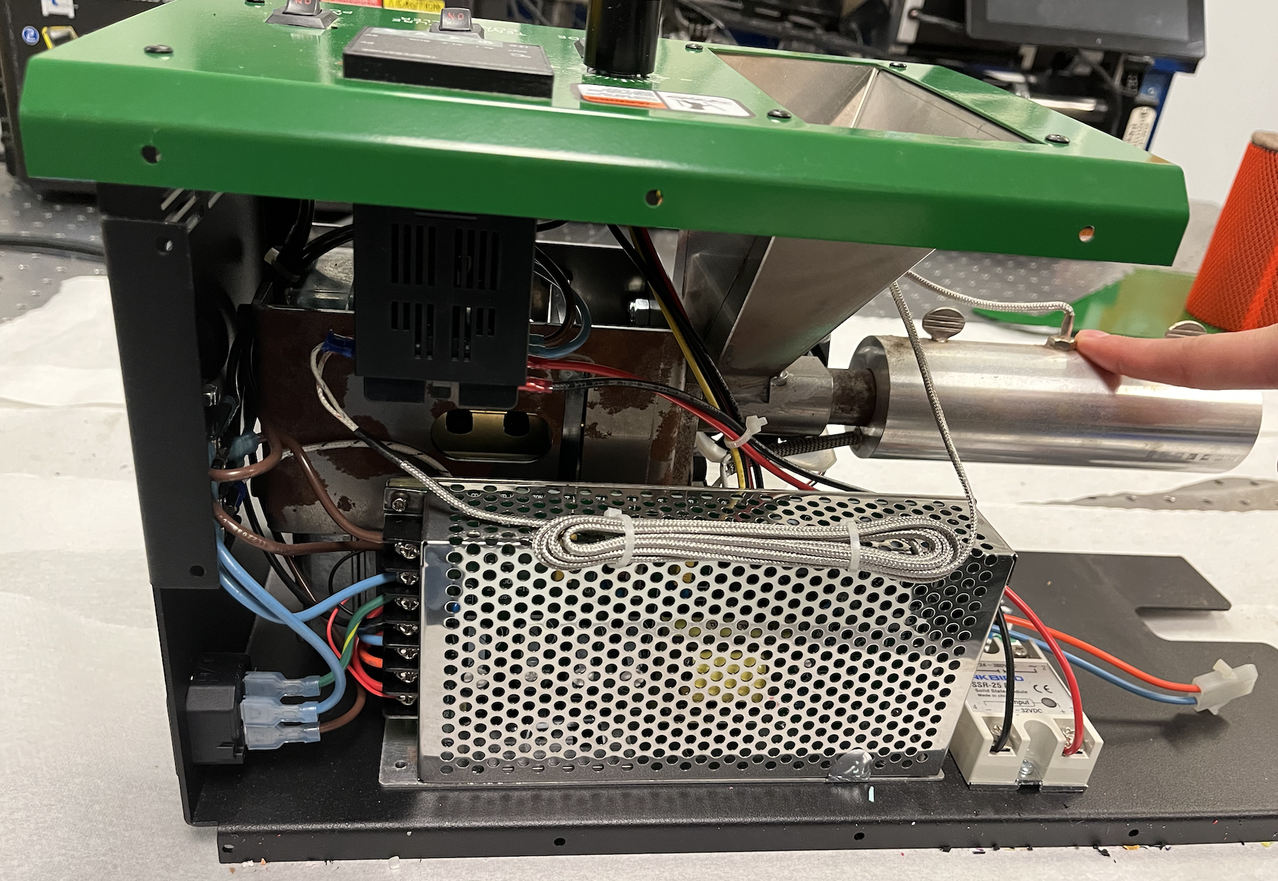
PARTS
SWITCHES OUTLET

Slide 3
PARTS
POWER SUPPLY UNIT (PSU)

Slide 4
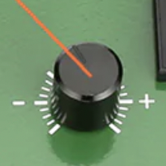
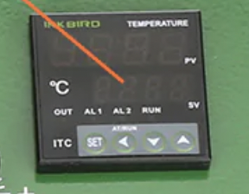
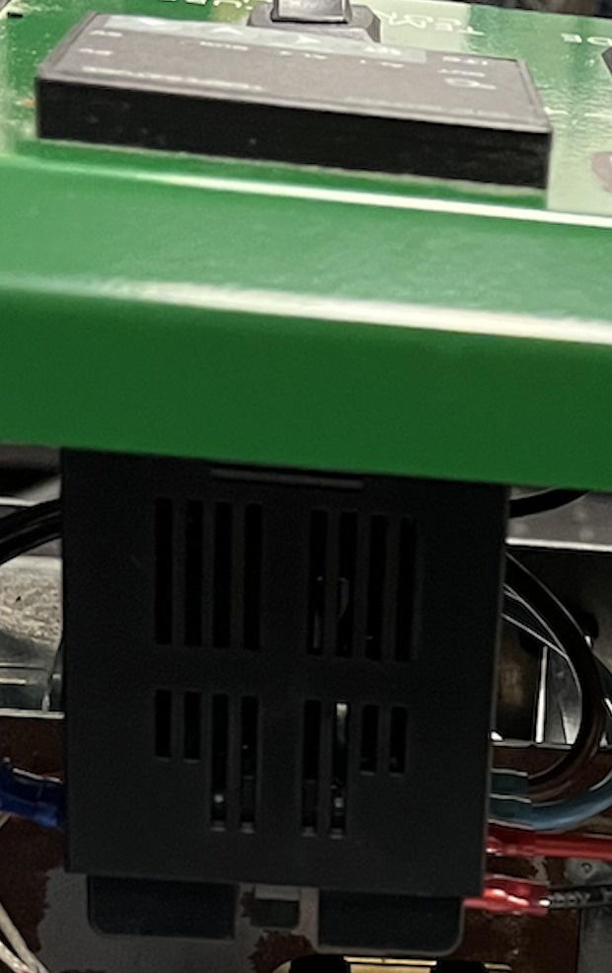
PARTS
SPEED CONTROLLER TEMPERATURE PID CONTROLLER
Exterior Panel

Slide 5
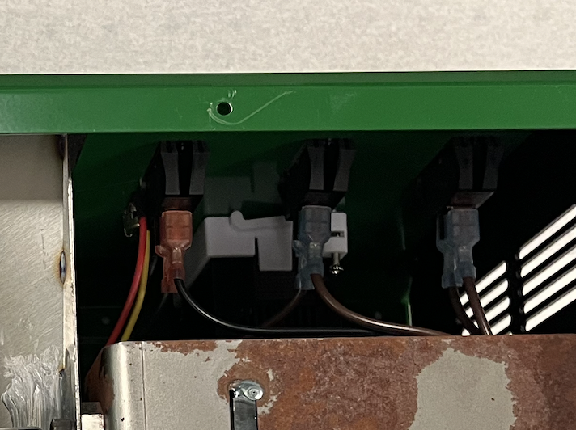
SWITCHES
Temperature Control
Main Power
Extruder

Slide 6
SWITCHES
Green Board
Temp Control Panel
Outlet
TEMP
CONTROLLER
MAIN POWER
(OFF)
EXTRUDE
(ON)
Power Supply
Circuit Board 1R
Circuit Board 1L

Slide 7
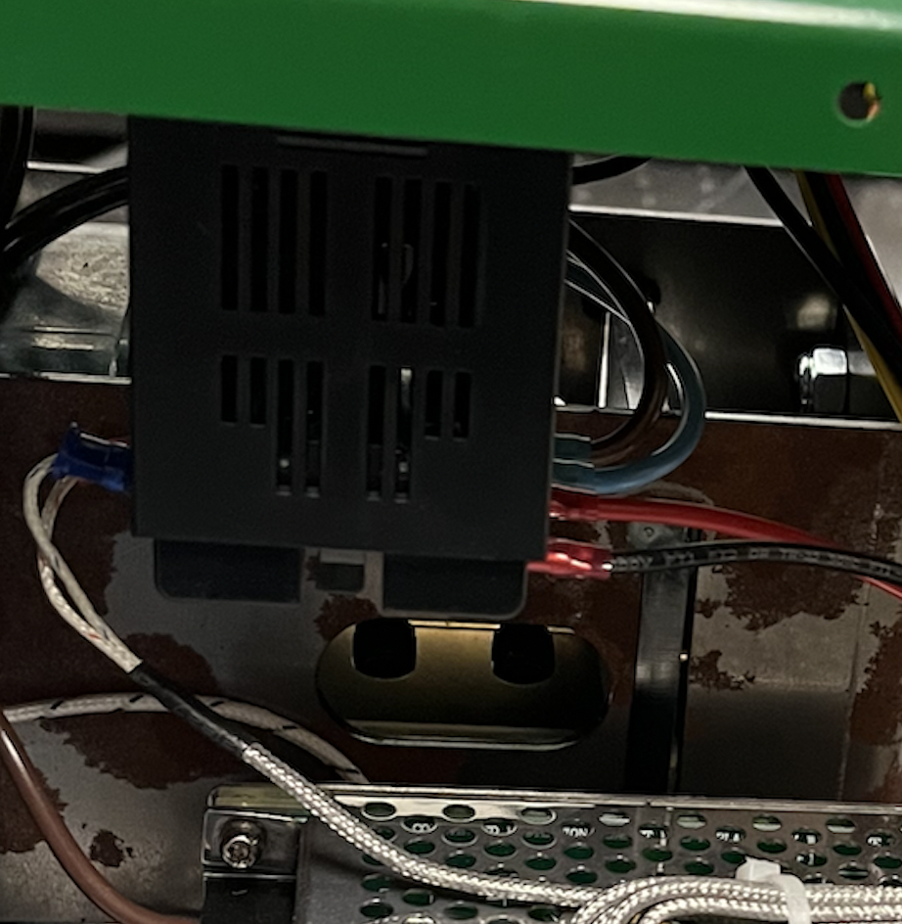
TEMPERATURE PID CONTROLLER
PID
OUT
IN

